Slide 1
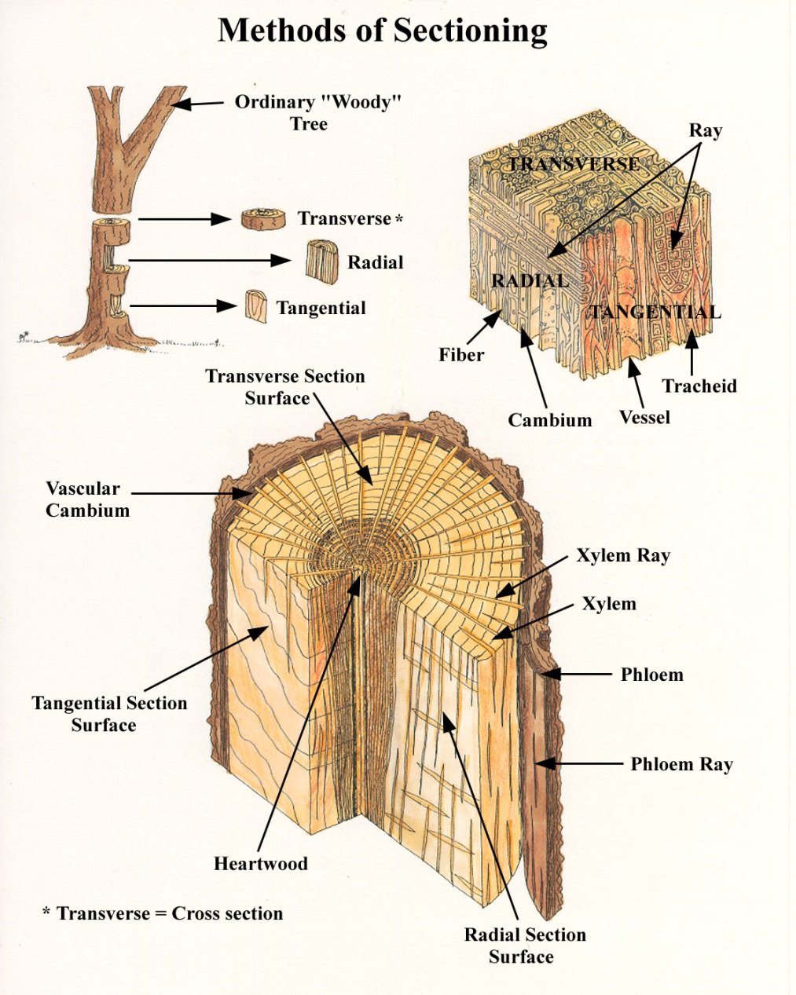
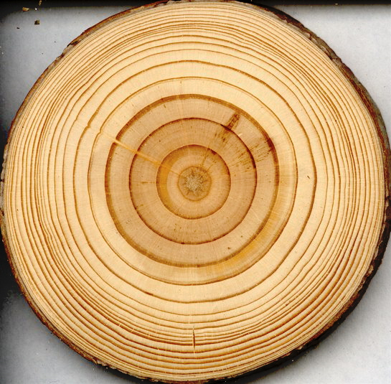
Station 1: Three Planes of Wood
Transverse
Figure 1
Figure 2
Transverse* or cross sectional surface is what you see when you look down on a tree trunk or at the end of a board or log.
A transvers cut reveals annual growth rings which appear as a series of circles in Figures 2.
Figure 2

Slide 2
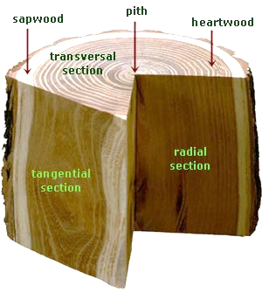
Station 1: Three Planes of Wood
bark
Radial
Figure 1
Figure 3
Radial section results from cutting longitudinally from the pith to the bark.

Slide 3

Station 1: Three Planes of Wood
Tangential
Figure 1
Figure 4
Tangential section is the plane which is perpendicular to the transvers cut and tangent to the bark.
This cut exposes growth rings as a series of wavy lines or stacked cones.

Slide 4
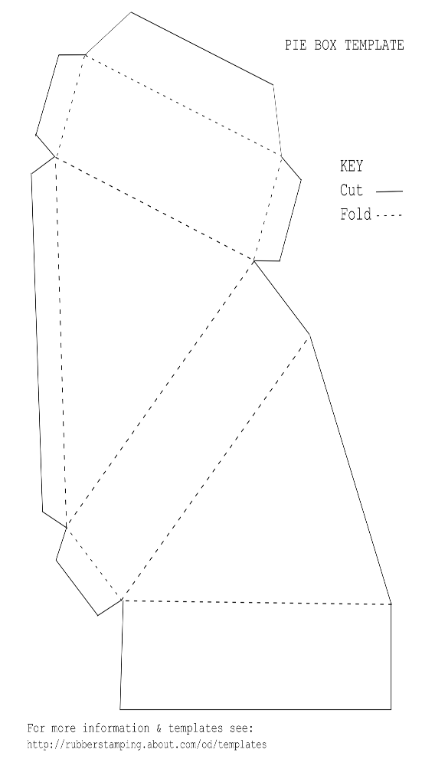
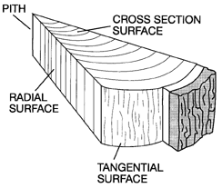
Station 1: Three Planes of Wood
Make a 3D Model of a Tree Wedge
Fold the paper pie box cut out along the dotted lines to form a 3D wedge.
2. Before taping or gluing the pie
box, label the surfaces as seen in
Figure 5.
  Transvers surface (cross section)
  Radial surface
  Tangential surface
Transverse surface
Tangential surface
Radial surface
Transvers surface
Pith
TRANSVERS SURFACE
Figure 5

Slide 5
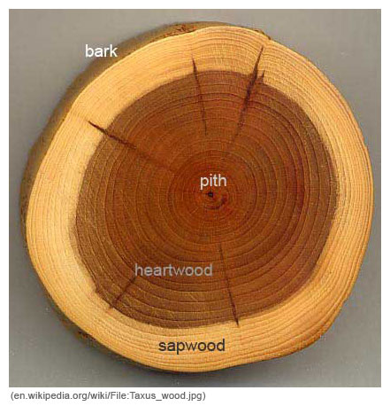
Station 2: Macroscopic Anatomy of a Tree Trunk
Features Seen in a Transvers Section
Figure 6 – Transvers section shows 3 key features (Pith, Bark and Xylem) of a tree trunk.
Pith is the oldest part of the tree and forms the core of the trunk.
Bark consists of outer layers of dead cells and
an inner layer of live, dividing cells. Bark has a
protective function, helping prevent attack by
insect and fungal pests, and stopping the
interior of the trunk from drying out.
Xylem – 2 main components
  Sapwood consists of live cells that carry and store water and nutrients from the roots to the rest of the tree.
  Heartwood is dead (physiologically inactive), darker color and is older xylem that has been infiltrated by resins and has lost its ability to conduct water.
Bark
Pith
Xylem
Figure 6

Slide 6
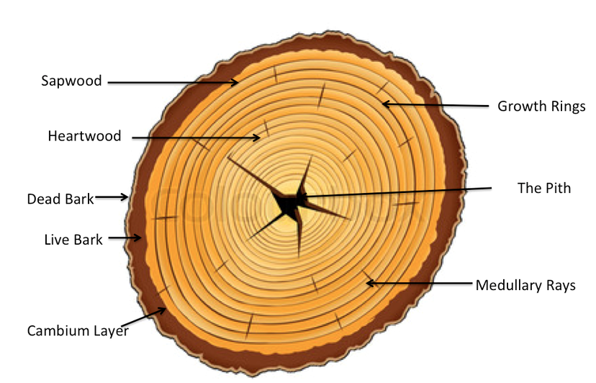
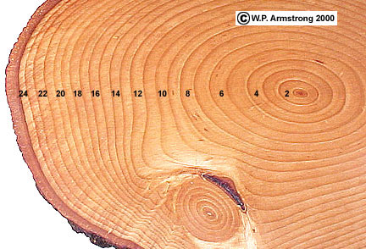
Station 2: Macroscopic Anatomy of a Tree Trunk
Features Seen in a Transvers Section
Figure 7
A cross-section of a tree shows a series of concentric rings. A tree ring is a layer of wood that results from periodic cellular growth.
Each growth ring formed over a year is called an annual ring
Figure 8
This tree trunk has 24 annual rings. The outside, darker layer on the left side of the photo is the bark of the trunk. The pith can be seen at the center of the ring.

Slide 7
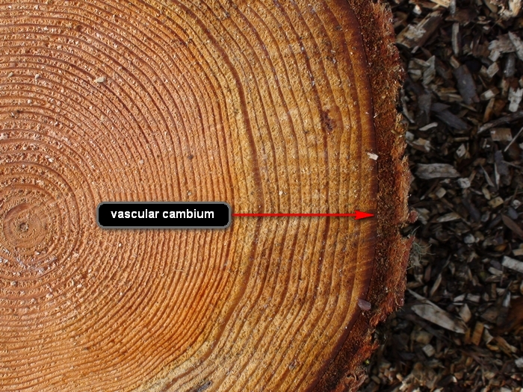
Station 2: Macroscopic Anatomy of a Tree Trunk
Features Seen in a Transvers Section
Figure 9
New layers of wood (annual ring) are added by the actively dividing cells of the cambium.
Cambium is a cellular plant tissue from which Xylem and Phloem grow by cellular division.

Slide 8
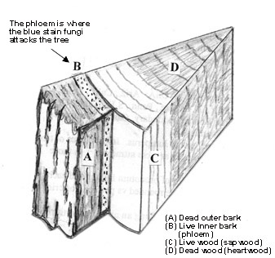
Station 2: Macroscopic Anatomy of a Tree Trunk
Features Seen in a Transvers Section
Adding to your 3D Model of a Tree Wedge
Draw tree rings on your paper tree wedge.
Label the pith, heartwood, sapwood and bark and cambium.
Pith
Cambium
Heartwood
Bark
Sapwood
Figure 5
Figure 10

Slide 9
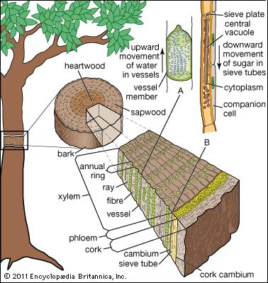
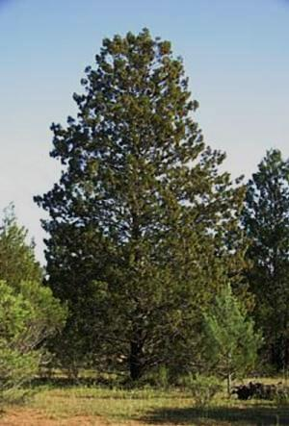
Station 3: Plant Vascular Systems
Xylem Functions to Conduct Water and Nutrients
XYLEM tissue conducts water and dissolved nutrients from the roots throughout the plant.
sugars
water and nutrients move one way
XYLEM
Water and nutrients move up while sugars move down to the roots.
Figure 11
Figure 12

Slide 10
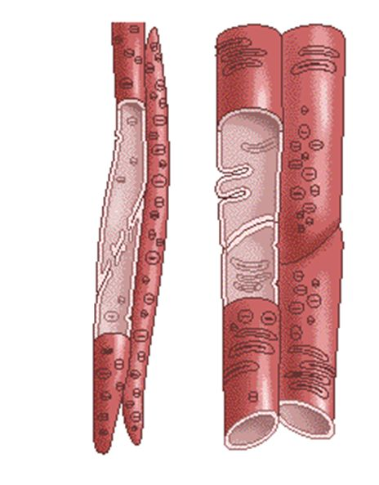
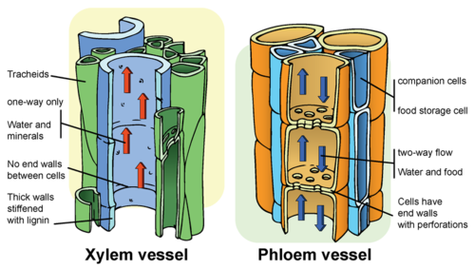
Station 3: Plant Vascular Systems
Xylem Functions to Conduct Water and Nutrients
Xylem Tracheid
Xylem Vessels
Cellular division in the cambium results in the production of Xylem tissue.
Xylem is a complex tissue composed of more than one cell type.
Xylem tissue of conifers is composed of elongate cells that form tubes with pointed ends called tracheids.
Tracheids are perforated and become hollow, water-conducting pipelines that also serve as support.
Xylem cells are thick walled cells that are dead at maturity.
Xylem vessels are perforated like tracheids but are shorter and fatter.
Perforated/pits
Figure 13
Tracheid
Figure 14

Slide 11
Station 3: Plant Vascular Systems
Phloem Functions to Conduction Sugars and Mineral
PHLOEM is developed from the Cambium.
PHLOEM
Figure 15
Figure 16

Slide 12
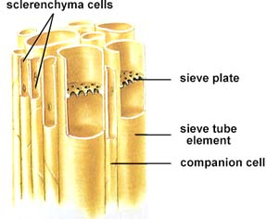
Station 3: Plant Vascular Systems
Phloem Functions to Conduction Sugars and Mineral
PHLOEM distributes the products of photosynthesis (mainly from the leaves) to the rest of the plants.
Like xylem phloem is a
complex tissue composed
of more than one cell type.
Phloem consists of
sieve cells
sieve tube elements
phloem parenchyma
phloem ray cells.
Phloem is always alive!
Companion
cells
Two way flow of water and food
Figure 17
Figure 18
Phloem cells as seen in longitudinal section. Note the longitudinal view of the sieve plate inside the large sieve tube cell.

Slide 13
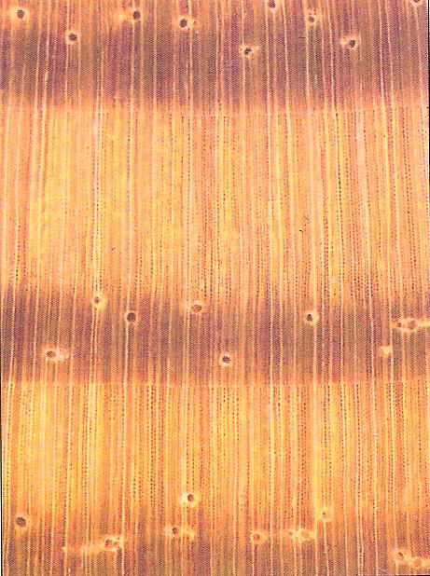
Station 4: Transvers Section
Microscopic view of Growth Rings (Earlywood and Latewood)
Growth Ring – is a ring of wood visible on the transverse surface of a tree section. Each ring results from periodic growth or cell division at the cambium. One year of growth is an annual ring which contains a region of earlywood and latewood.
Earlywood – is that portion of a growth produced at the beginning of the growing season (spring wood).
Latewood – is that portion of an annual growth produced during the latter part of the growing season (summer wood).
Earlywood
Latewood
Figure 19

Slide 14
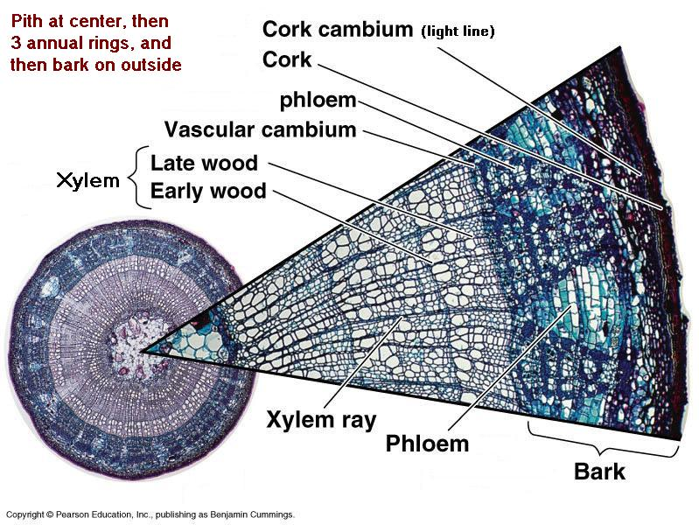
Station 4: Transvers Section
Microscopic view of Earlywood and Latewood
Microscopic cross sectional view of the annual rings (xylem tissue) reveal a pattern of alternating larger and smaller lumen = tubes = tracheid cells.
In pines, the tracheid cells of earlywood (spring tracheids) have larger openings than the tracheid cells of latewood (summer tracheids).
Summer tracheids are smaller and more dense making them appear as dark rings.
Each concentric ring of spring + summer tracheids is called an annual ring.
Cross Section of Stained Wood
Figure 12
Figure 20

Slide 15
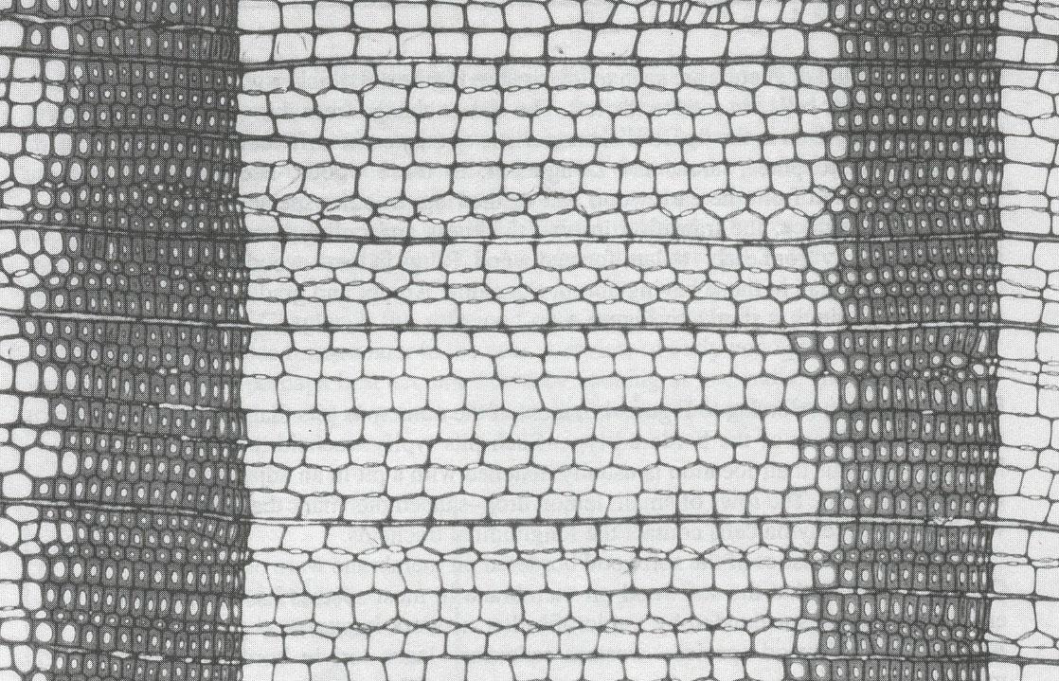
Station 4: Transvers Section
Electron Microscopy of Earlywood and Latewood
Latewood
- smaller diameter cells
- thicker cell walls
Earlywood
- large diameter cells
- lower density than latewood
Latewood
- smaller diameter cells
- thicker cell walls
Figure 21

Slide 16
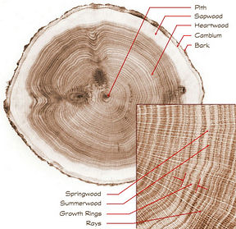
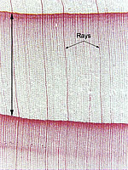
Station 5: Micro­scopic Tree Anatomy
Rays and Resin Ducts
Wood rays extend from the cambium into the xylem and phloem.
Wood rays conduct fluids and sap radially.
Wood rays appear in cross section like a spoke on a wheel
Microscopic cross section showing growth ring and rays
Rays
Figure 23
Rays - narrow vertical lines consists of tracheids.
Vertical Double-headed arrow indicates a single thick annual ring.
Figure 22

Slide 17
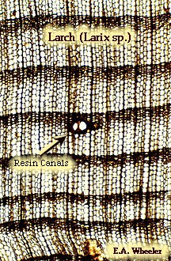
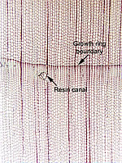
Station 5: Micro­scopic Tree Anatomy
Rays and Resin Ducts
The radial resin ducts and the cells serve two functions in the defense of trees.
Synthesis of new resin/sap
Delivery of resin/sap to pitch out attacking beetles.
Rays
Growth ring boundary
Resin Canal
Resin Canal
Figure 24
Microscopic cross sections showing resin canals
Pines, spruces, Larch, and Douglas Fir have "tubes" lined by epithelial cells that produce resin.
Resin seals wounds caused by insects or other damage
Resin canals are oriented longitudinally.

Slide 18
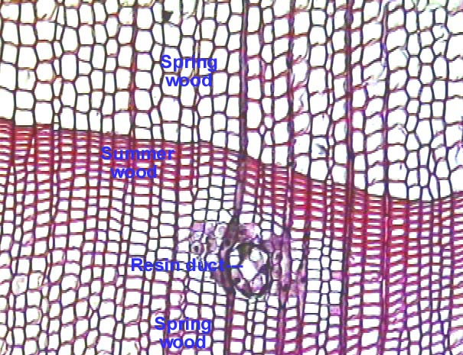
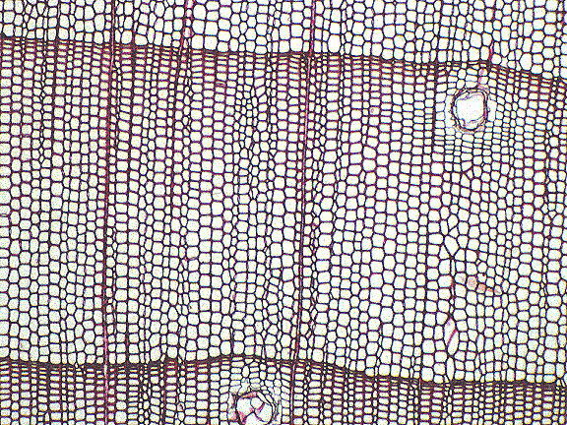
Station 6: Micro­scopic Tree Anatomy
Histology
1. View the microscope slide of the transverse section of Pinus stobus.
2. Look for some of the feature(s) seen in the image of Pinus wood below.
Rays
Spring wood
Summer wood
Resin duct
Resin duct
Pinus wood ts x40
Spring wood
Figure 25
Pinus wood ts x100.

Slide 19
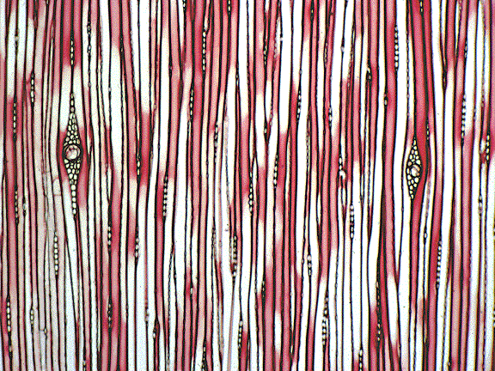
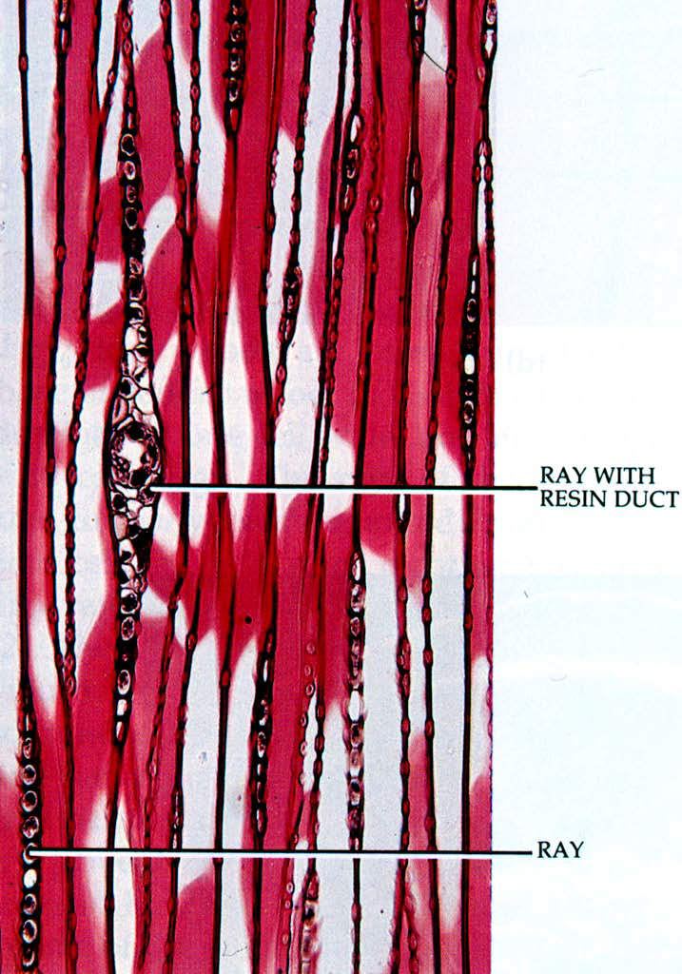
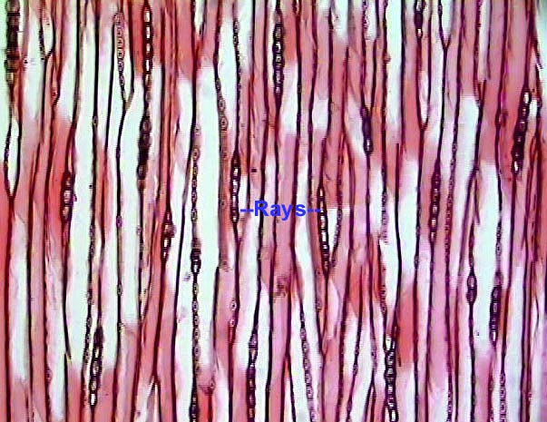
Station 6: Micro­scopic Tree Anatomy
Histology
1. View the microscopic tangential section of Pinus stobus.
2. Look for some of the feature(s) seen in the Pinus wood images below.
Pinus wood ts x40
Figure 26
Pinus wood ts x100. Short rays one cell in width are seen in this tangential section.

Slide 20
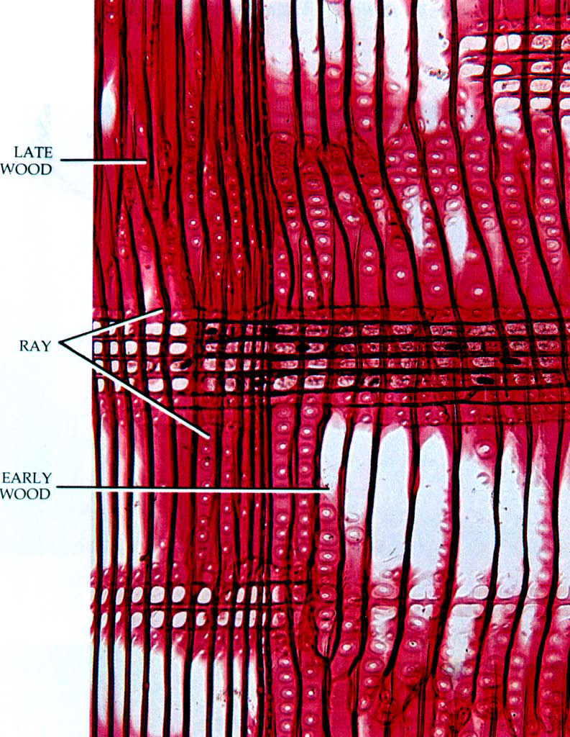
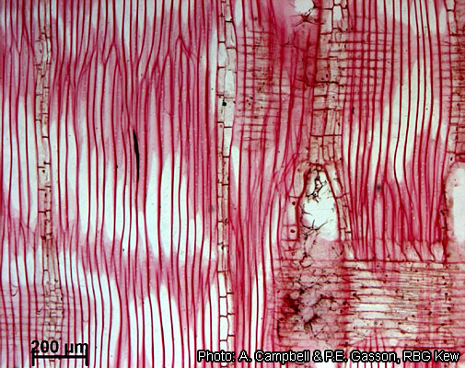
Station 6: Micro­scopic Tree Anatomy
Histology
1. View the microscopic radial section of Pinus stobus.
2. Look for some of the feature(s) seen in the radial sections below.
Radial Section
Figure 27

Slide 21
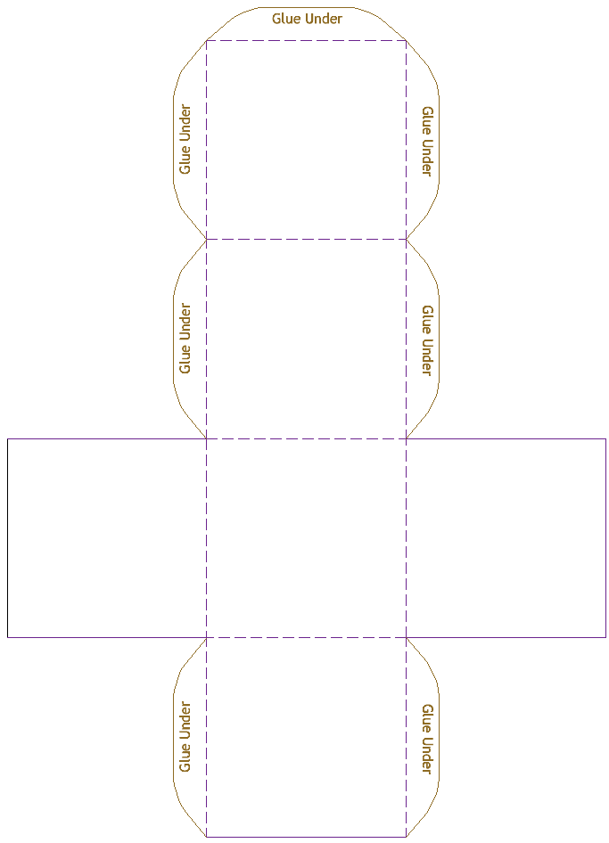
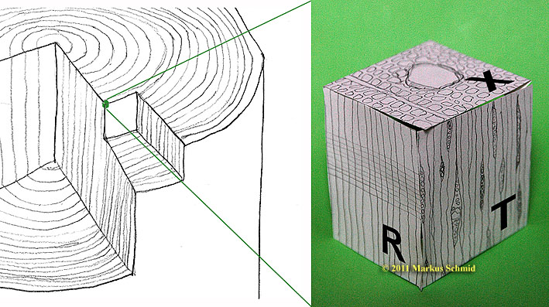
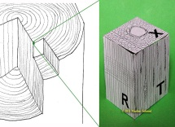
Station 7: Micro­scopic Tree Anatomy
Histology Cube
1. View a microscope slide of Pinus strobus and/or Pinus ponderosa.
2. View both 4X and 10X, draw the histological section on the appropriate face of the cube.
3. Use additional images from figures 29 and 30 to help you draw and label your
histology cube.
4. When you have completed your drawings use the glue stick to make the box.
Tangential Plane
Cross or Transverse Plane
Bottom
Figure 28
Radial Plane

Slide 22
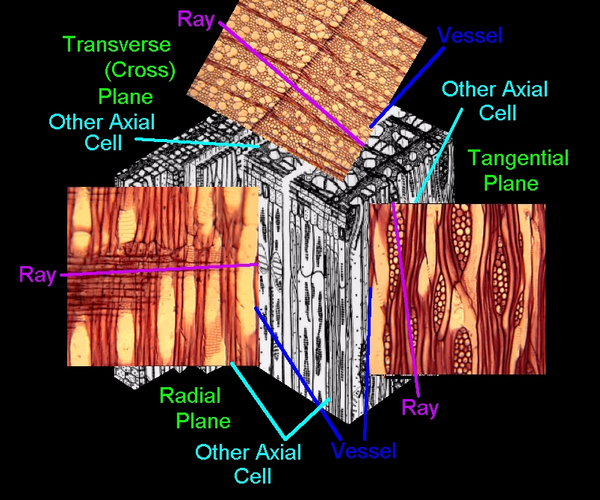
Station 7: Micro­scopic Tree Anatomy
Histology Cube
Use this figure to help you label your Histology Cube of Pinus strobus.
Figure 29

Slide 23
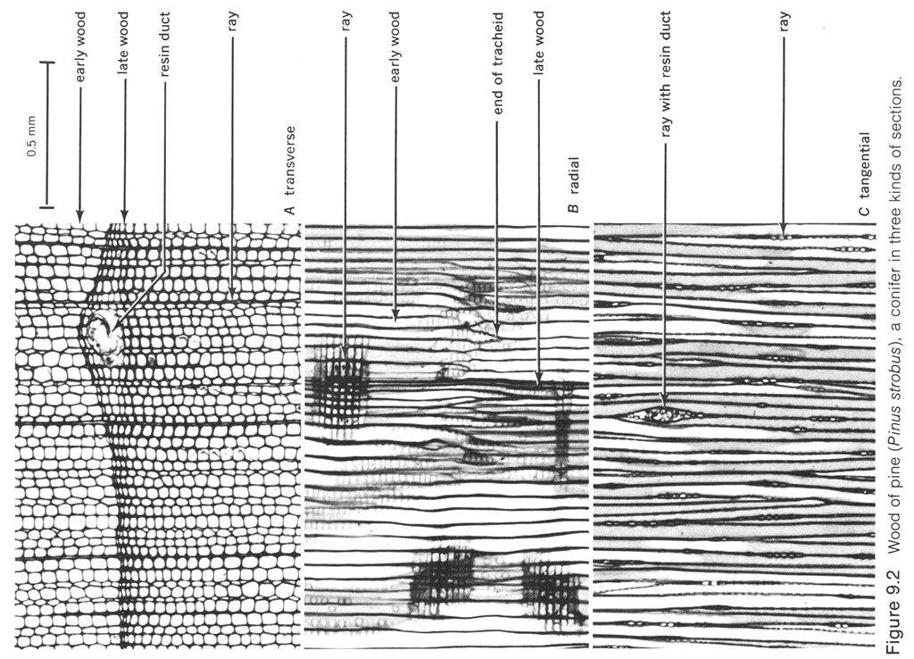
Figure 30
Station 7: Micro­scopic Tree Anatomy
Histology Cube
Use this figure to help you label your histology drawings of Pinus strobus.

Slide 24
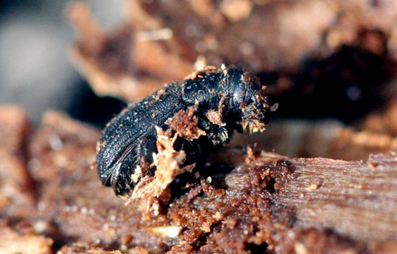
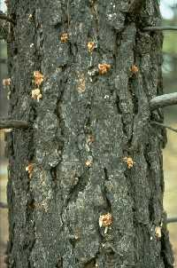
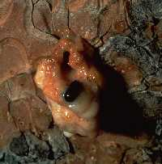
Station 8: Mountain Pine Beetle
Mountain Pine Beetles attack trees by boring through the bark.
A sign that a tree has been attached by mountain pine beetles is the presence of boring dust in bark crevices.
Another sign is popcorn-shaped masses of resin, called "pitch tubes," on the trunk where beetle tunneling begins.
Pitch tubes may be brown, pink or white
Figure 31

Slide 25
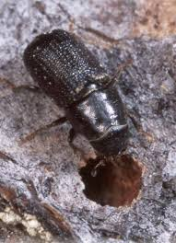
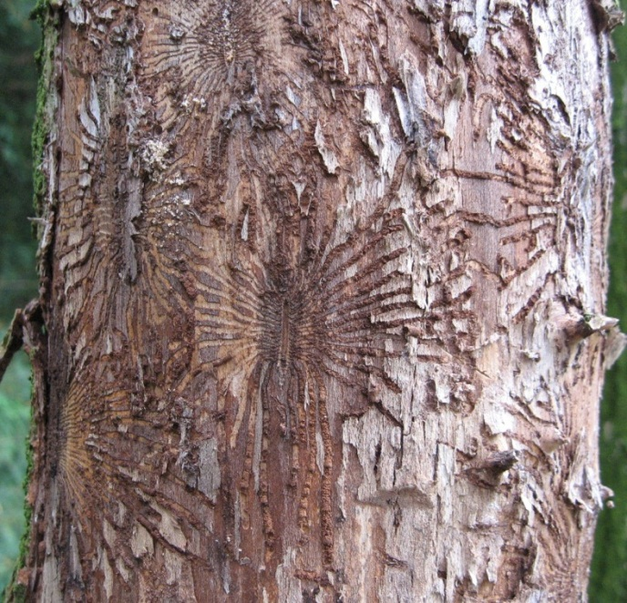
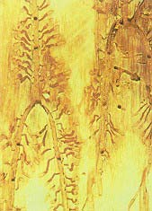
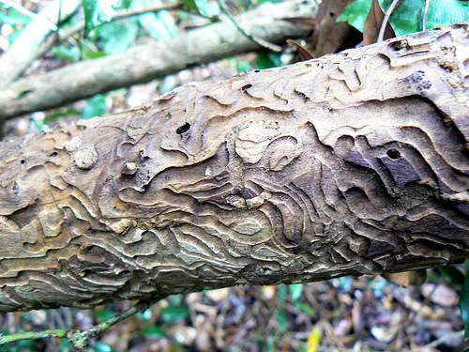
Station 8: Mountain Pine Beetle
Adult female beetles bore into the inner bark called the phloem.
Beetles create galleries and the shape of the gallery is specific to the beetle and tree type.
Beetles lay eggs in the galleries.
Figure 32

Slide 26
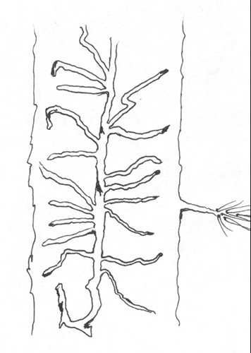
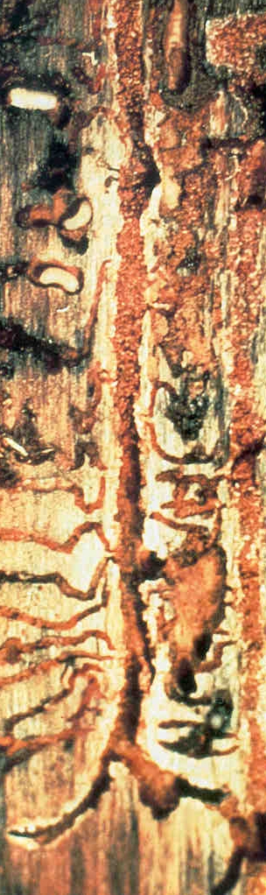
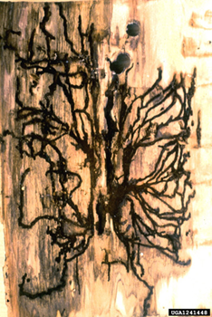
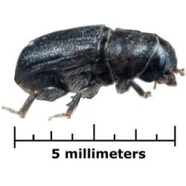
Station 8: Mountain Pine Beetle
The mountain pine beetle create vertical galleries with a J-shaped hook on the end.
Figure 33

Slide 27
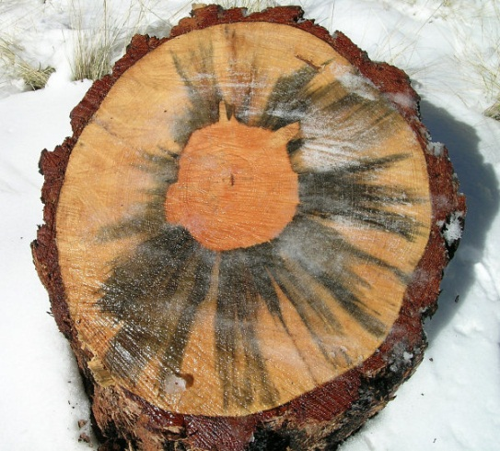
Station 8: Mountain Pine Beetle
Blue stain fungi have evolved relationships with mountain pine beetles that allow them to travel on a special structure in the beetle's mouthparts, and feed on the living tissue (phloem) of the tree.
After the beetle introduces the fungi to the tree. The blue stain fungi grow rapidly into the sapwood, slowing the movement of fluids and disrupting the tree’s defenses against the invading beetles.
Eventually the tree dies due to lack of moisture.

Slide 28
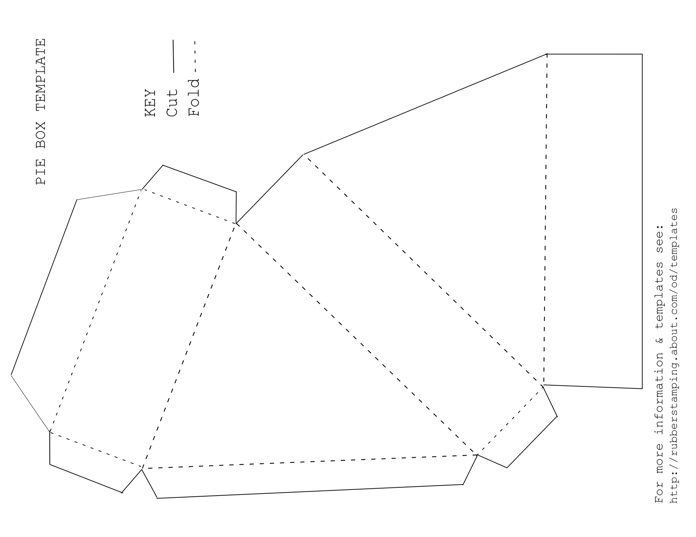
Cross or Transverse section
Radial section
Tangential section
Pith
Cross or Transverse section
Pith

Slide 29
Tangential Plane
Cross or Transverse Plane
Bottom
Radial Plane

